Slide 1
hMC
Module-04

Slide 2
Contents
hybris Management Console
Overview of the hMC
Storing Layout Configuration
hMC Localization
Type System Localization

Slide 3
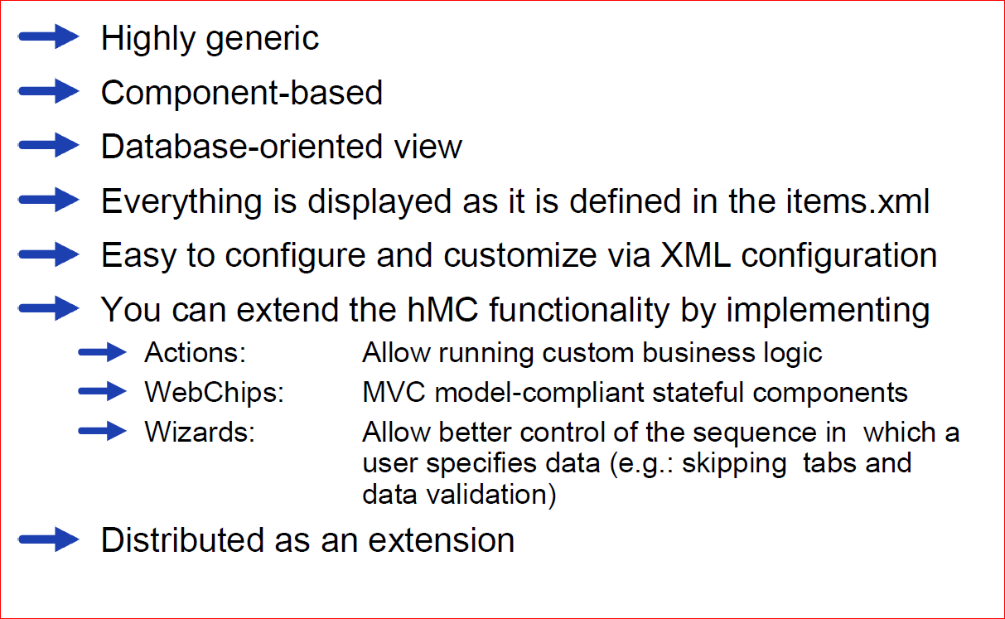
What is the hybris Management Console?

Slide 4
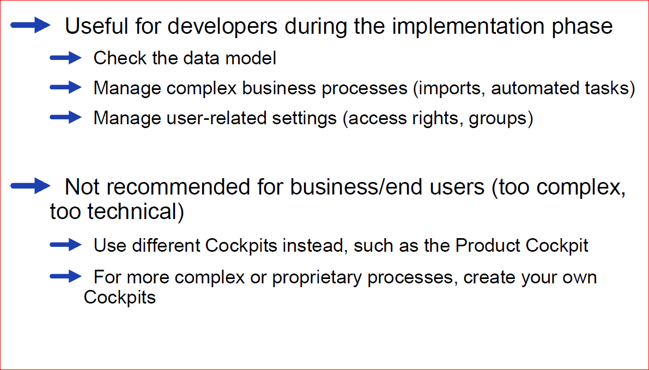
hMC – Use Cases

Slide 5
Contents
hybris Management Console
Overview of the hMC
Storing Layout Configuration
hMC Localization
Type System Localization

Slide 6
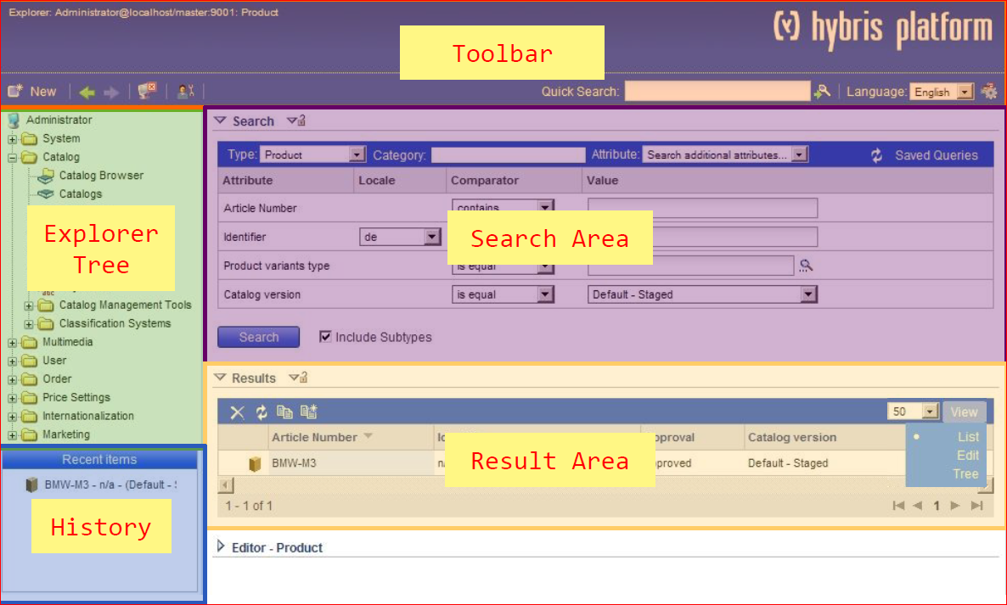
hMC – Components

Slide 7
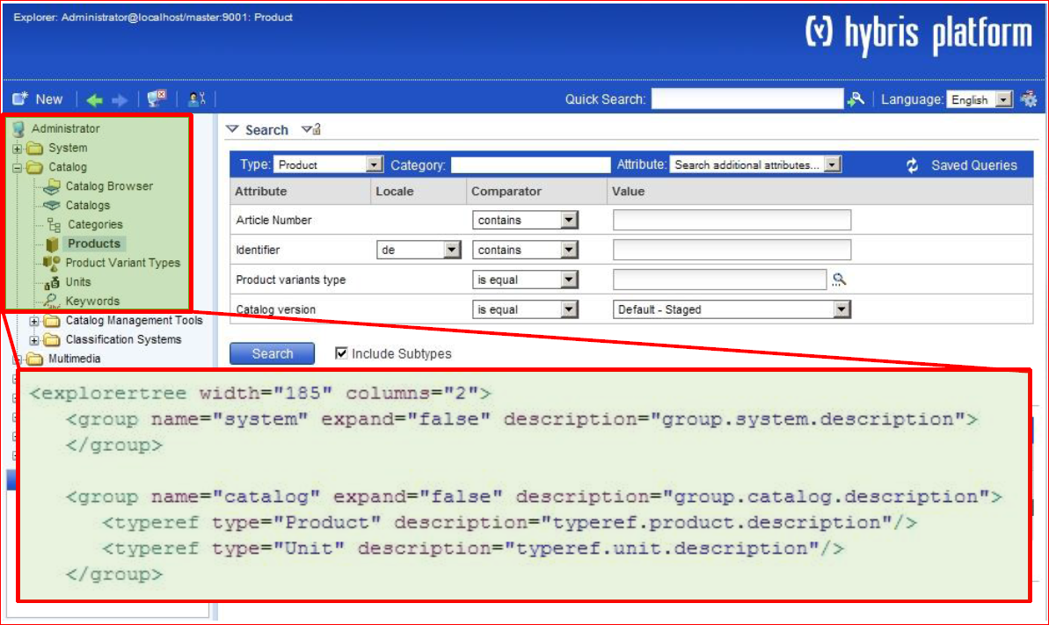
hMC Tree

Slide 8
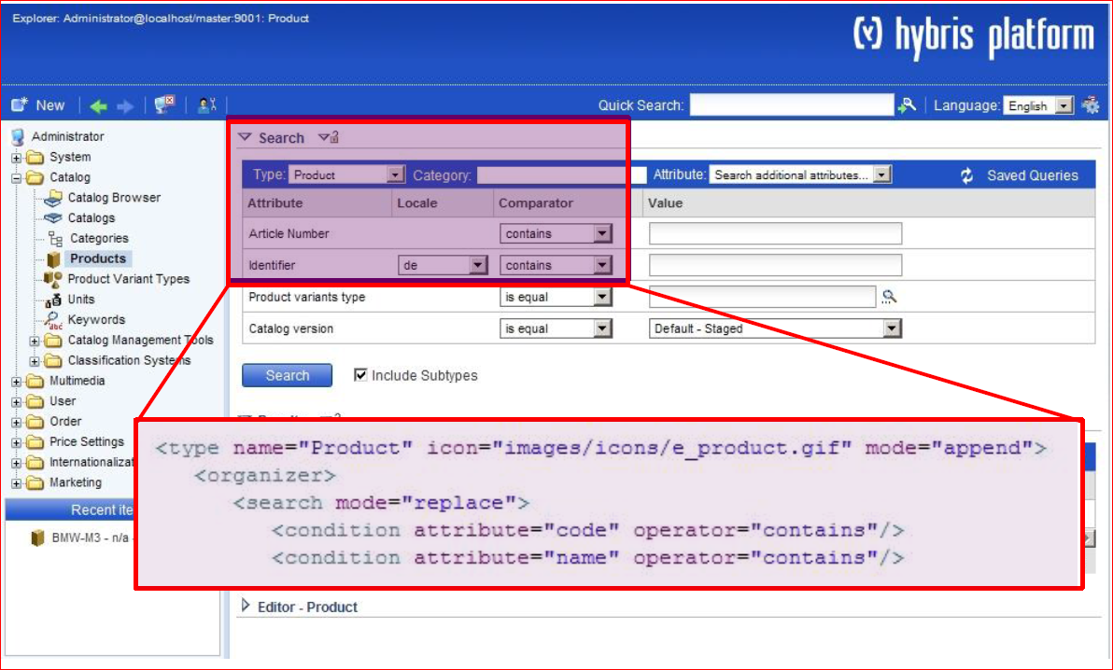
hMC Search

Slide 9
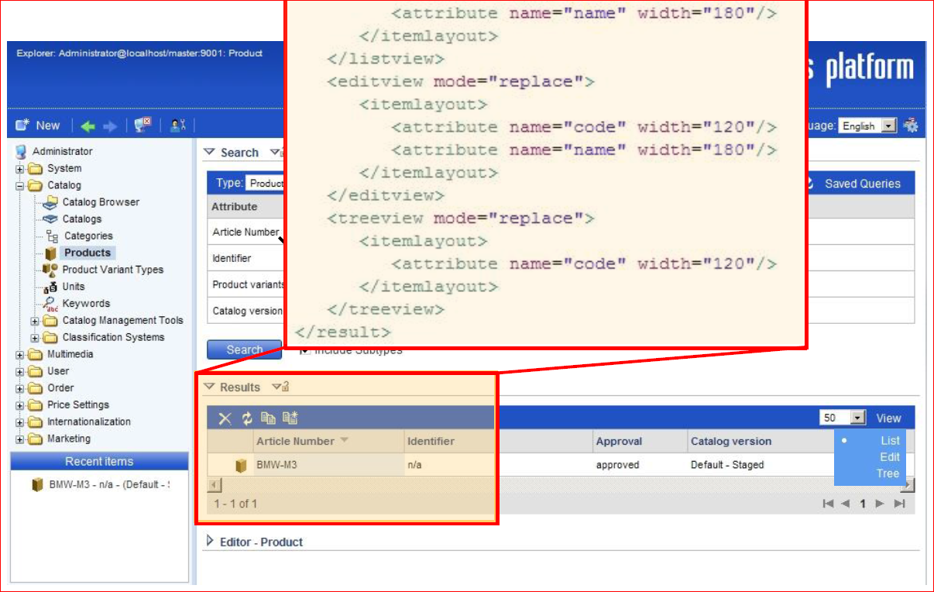
hMC Result

Slide 10
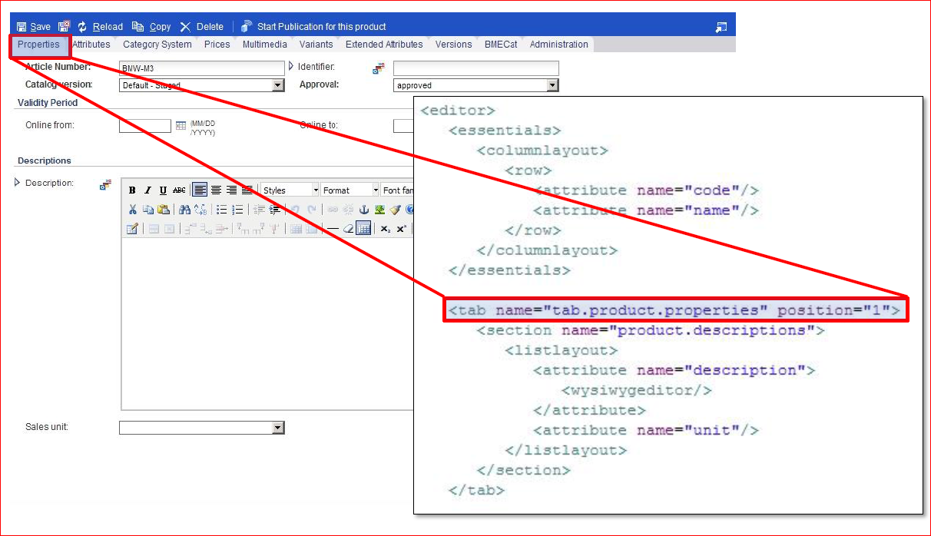
hMC Editor – Tab

Slide 11
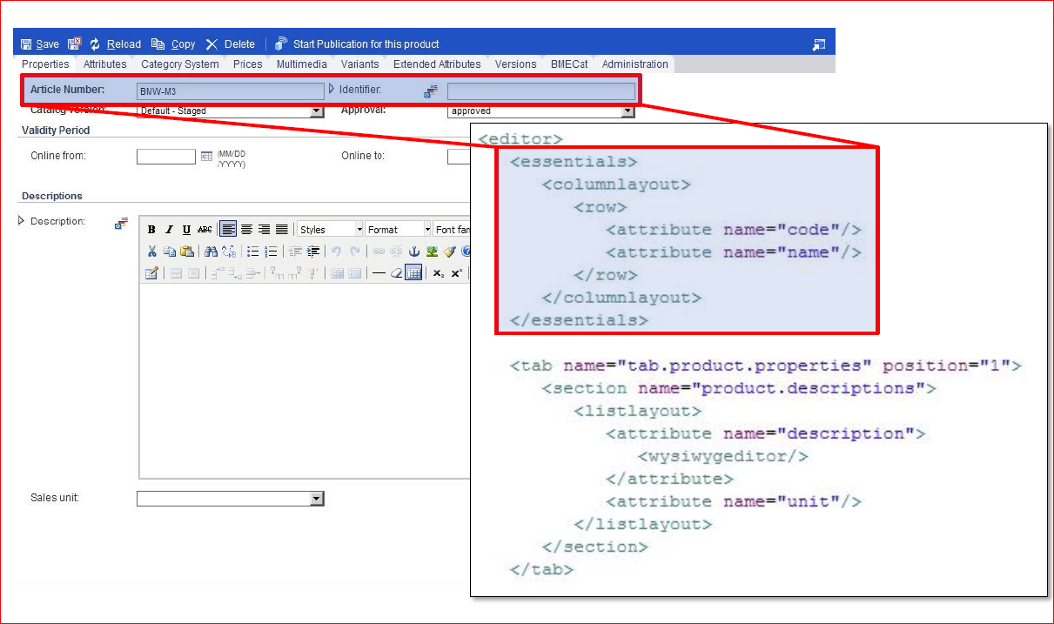
hMC Editor – Essentials

Slide 12
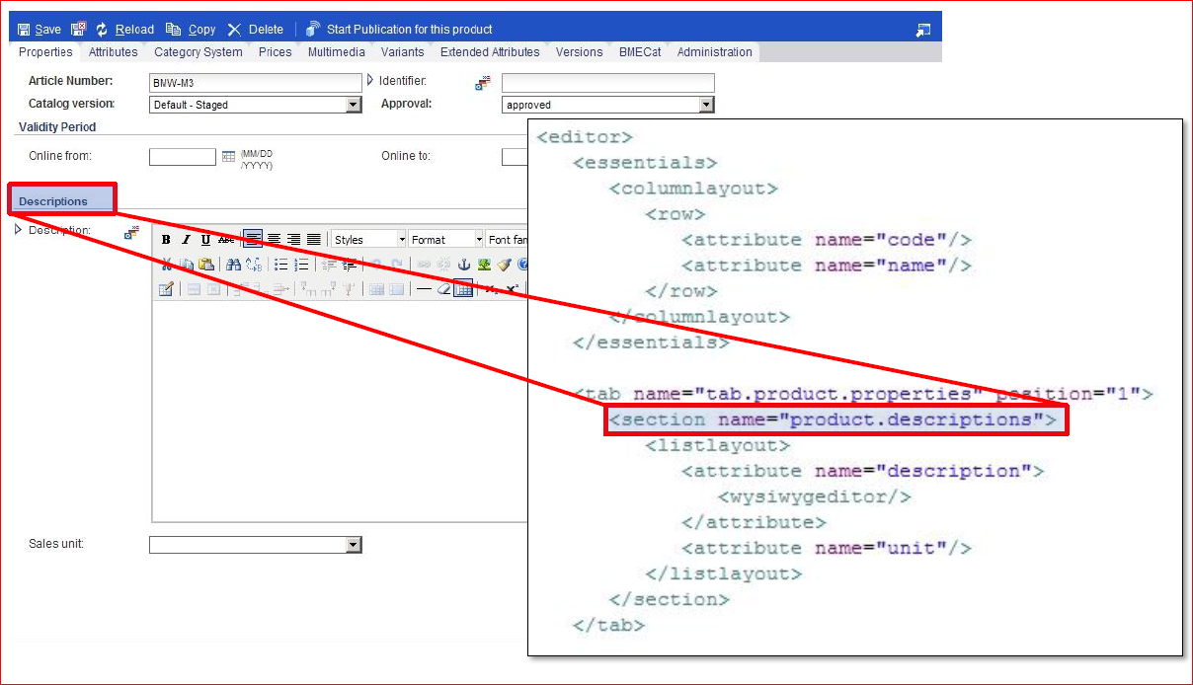
hMC Editor – Section

Slide 13
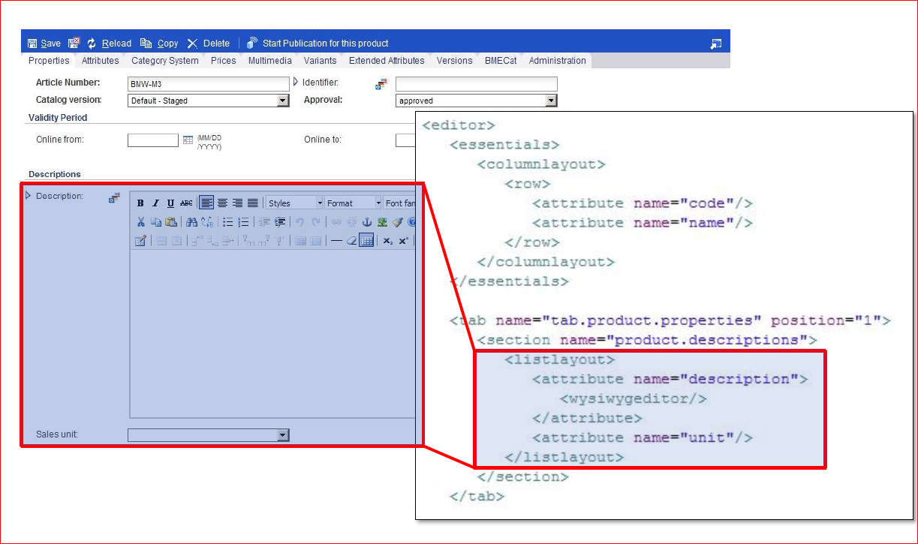
hMC Editor – Attributes

Slide 14
Contents
hybris Management Console
Overview of the hMC
Storing Layout Configuration
hMC Localization
Type System Localization

Slide 15
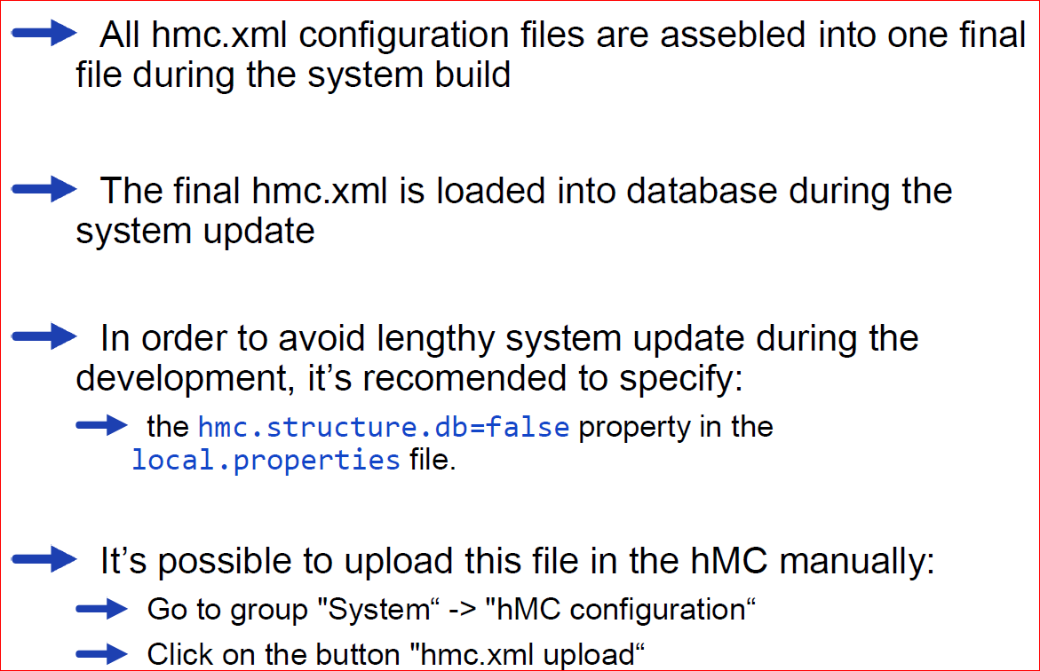
Storage Location for XML Definition

Slide 16
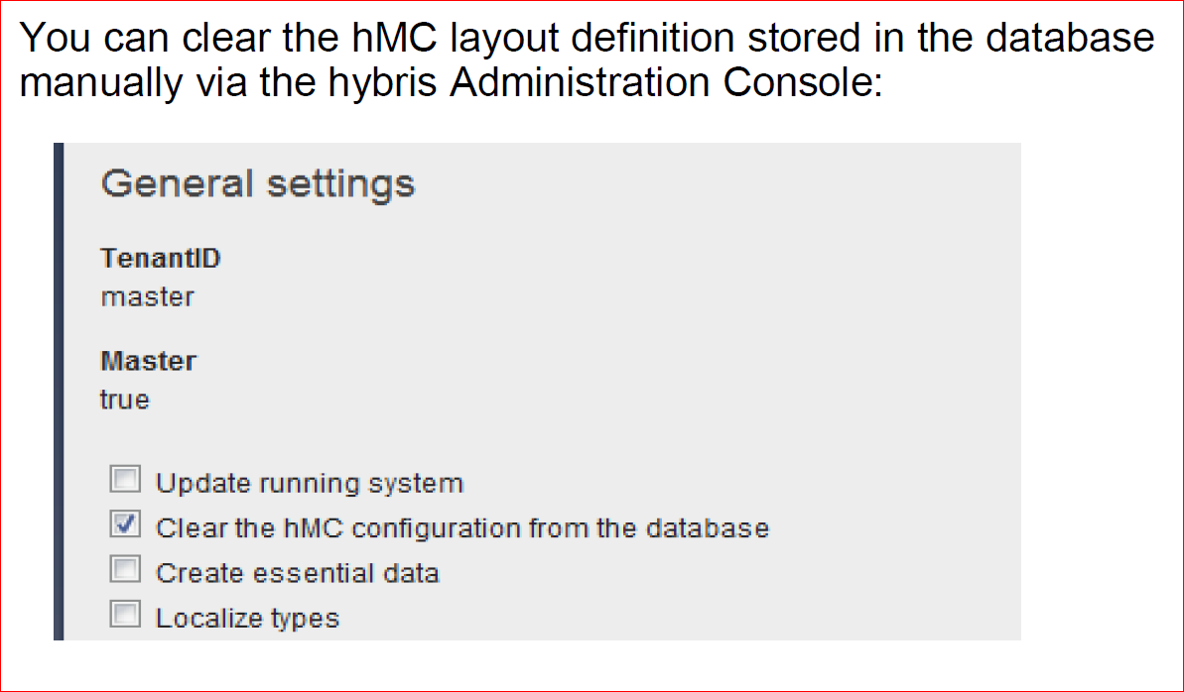
Clearing the hMC Configuration From the Database

Slide 17
Contents
hybris Management Console
Overview of the hMC
Storing Layout Configuration
hMC Localization
Type System Localization

Slide 18
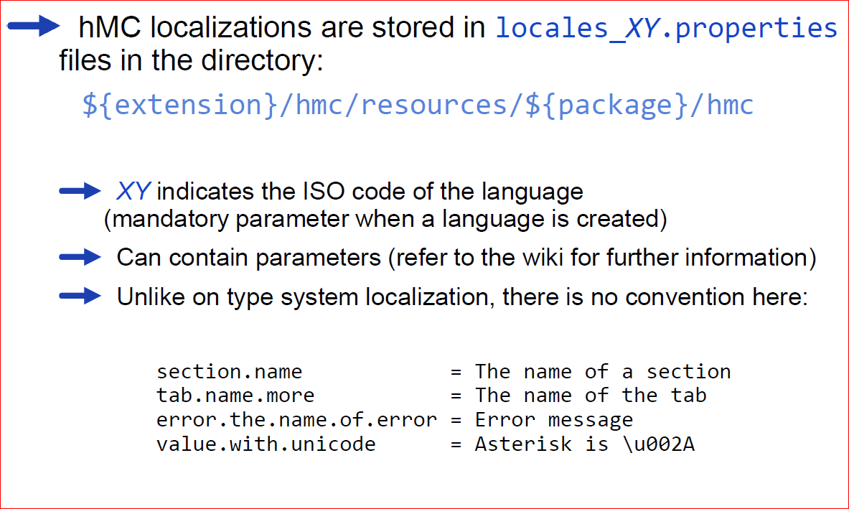
hMC – Localization

Slide 19
Contents
hybris Management Console
Overview of the hMC
Storing Layout Configuration
hMC Localization
Type System Localization

Slide 20
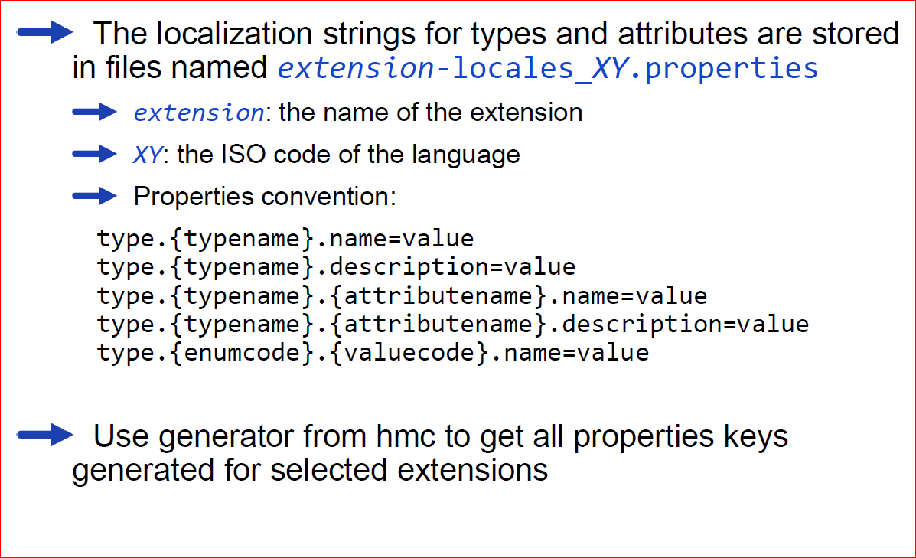
Type System Localization

Slide 21
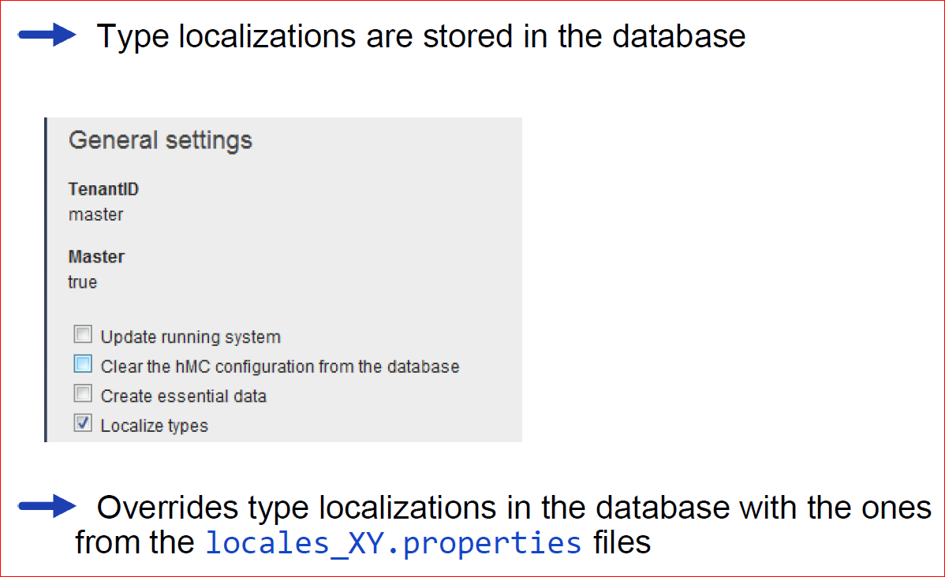
System Initialization / Update – Localize Types

Slide 22
Quizees
1.What does the abbreviation hMC stand for?
2.When would you use the hMC and when would you use the hybris Administration Console?
3.Which file is used to configure hMC layout?
4.What do you have to do after modifying the hMC configuration-file?
5.What is the difference between type system localization and hMC localization?

